Slide 1
Business Intelligence (BI)
Overview and Trends

Slide 2
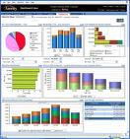


What is Business Intelligence?
Business Intelligence enables the business to make intelligent, fact-based decisions
Aggregate Data
Present
Data
Enrich
Data
Inform a Decision
Database, Data Mart, Data Warehouse, ETL Tools, Integration Tools
Reporting Tools, Dashboards, Static Reports, Mobile Reporting, OLAP Cubes
Add Context to Create Information, Descriptive Statistics, Benchmarks, Variance to Plan or LY
Decisions are Fact-based and Data-driven

Slide 3
CPU – Content, Performance, Usability
Content
The business determines the “what”, BI enables the “how”
Performance
Minimize report creation and collection times (near zero)
Usability
Delivery Method →Push vs Pull
Medium → Excel, PDF, Dashboard, Cube, Mobile Device
Enhance Digestion → “A-ha” is readily apparent, fewer clicks
Tell a Story → Trend, Context, Related Metrics, Multiple Views

Slide 4
How Important is BI?
Top 10 Business and Technology Priorities for 2016:
1. Cloud computing 2. Virtualization 3. Mobile technologies 4. IT Management 5. Business Intelligence 6. Networking, voice and data communications 7. Enterprise applications 8. Collaboration technologies 9. Infrastructure 10. Web 2.0
Source: Gartner’s 2011 CIO Agenda (aka “Reimagining IT: The 2011 CIO Agenda”).

Slide 5

Why is Business Intelligence So Important?
Time
Data
Opinion
(aka Best Professional Judgment)
Making Business Decisions is a Balance
With Business Intelligence, we can get data to you in a timely manner.
In the absence of data, business decisions are often made by the HiPPO.

Slide 6
Major BI Trends
Mobile
Cloud
Social Media
Advanced Analytics

Slide 7
What BI technologies will be the most important to your organization in the next 3 years?
Predictive Analytics
Visualization/Dashboards
Master Data Management
The Cloud
Analytic Databases
Mobile BI
Open Source
Text Analytics

Slide 8
Advanced Analytics / Predictive Analytics
Data Mining
Regression
Monte Carlo Simulation
“Statistically Significant”
Predicting Customer Behavior
Churn/Attrition
Purchases
Profiling

Slide 9
BI Today vs Tomorrow
“BI today is like reading the newspaper”
BI reporting tool on top of a data warehouse that loads nightly and produces historical reporting
BI tomorrow will focus more on real-time events and predicting tomorrow’s headlines

Slide 10
Retail Analytics
Market Basket Analytics
Text Analytics
Customer Segmentation/Clustering
Tailored Product Assortments
Inventory Forecasting

Slide 11

Amazon.com and NetFlix
Collaborative Filtering tries to predict other items a customer may want to purchase based on what’s in their shopping cart and the purchasing behaviors of other customers

Slide 12
What Is Text Analytics?
…turning unstructured customer comments into actionable insights
…finding nuggets of insight in text data that will improve our business
From Wikipedia:
… a set of linguistic, statistical, and machine learning techniques that model and structure the information content of textual sources for business intelligence, exploratory data analysis, research, or investigation

Slide 13


Unstructured Text Processing
Facebook Page
Twitter
Page
Customer Sat Survey Comments
Call
Center
Notes,
Voice
Services
Quality
Cost
Friendliness
Competitors’ Facebook
Pages
Public Web Sites,
Discussion Boards, Product Reviews
Email
Blogs
Alerts,
Real-time Action
Adhoc Feedback

Slide 14
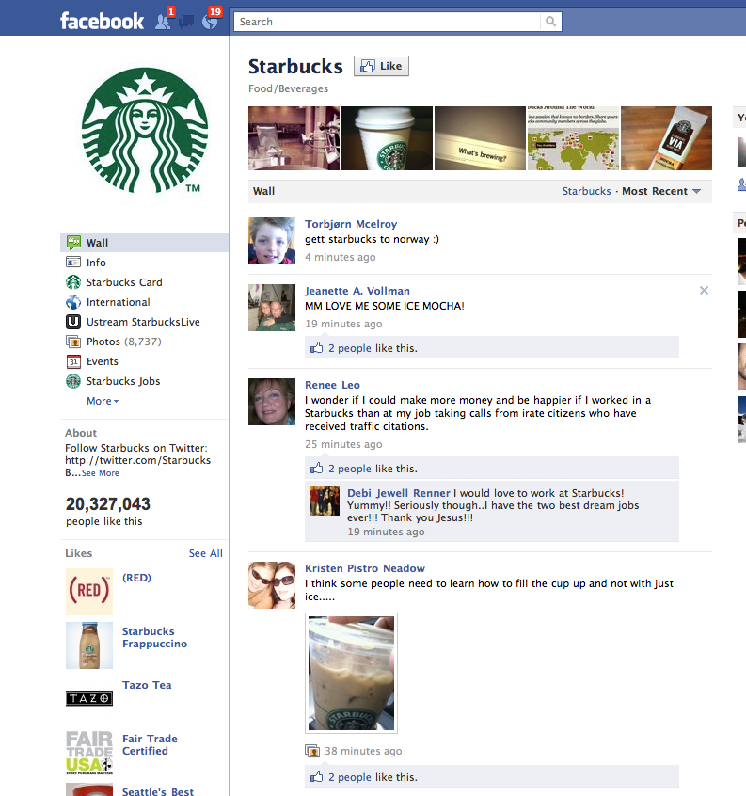

Slide 15
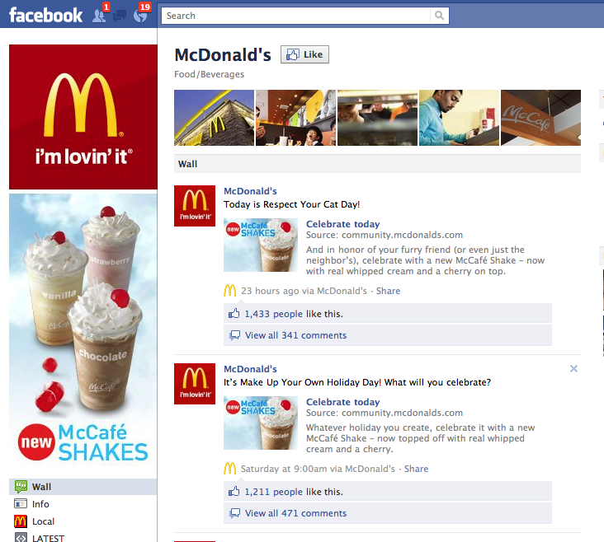

Slide 16
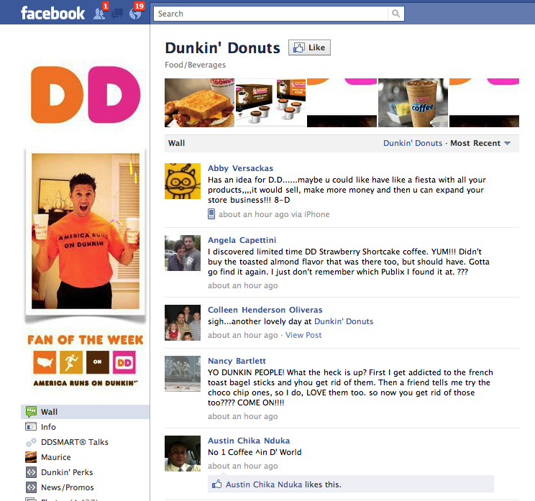

Slide 17

What is Information Governance?
Information Governance
PREVENTS
Garbage In
Garbage Out
BY ENCOMPASSING
Data Stewardship
Data Quality
Data Governance
Master Data Management
Data Stewards for Master Data “Hubs”
Customer, Vendor, Product, Location, Employee, G/L Accounts
Report Governance
Metric Governance
CREATING SIGNIFICANT BUSINESS VALUE

Slide 18
BI Technologies
Analytic Databases
BI is a consolidating industry
Oracle: Siebel, Hyperion, Brio, Sun
SAP: Business Objects, Sybase
IBM: Cognos, SPSS, Coremetrics, Unica, Netezza
EMC: Greenplum
HP: Vertica
Teradata: Aster Data
Independent vendors: MicroStrategy, Informatica, SAS
Reporting standards determined mainly by Microsoft, Apple and Adobe
DB2
Oracle
SQL Server
Teradata
Netezza
Vertica
Aster Data
Par Accel
Greenplum
Semantic Databases
(TIDE)

Slide 19
BI Technologies (cont’d)
If you want to learn more about Analytic Databases:
http://hosted.mediasite.com/mediasite/Viewer/?peid=120d6b7ba227498b96a8c0cd01349a791d
If you want to learn more about BI in the Cloud:
http://hosted.mediasite.com/mediasite/Viewer/?peid=e6d91148a71a47969824c22b3b20d6221d

Slide 20
Thank You

